Slide 1
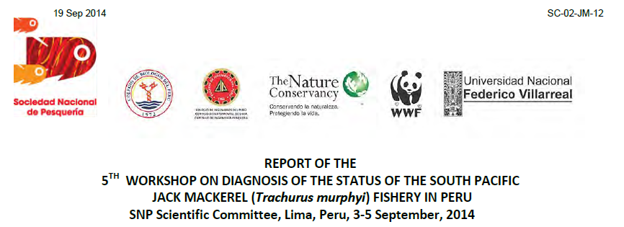
Notes:
the SC of the National Fisheries Society of Peru- SNP is organizing an annual workshop on “Diagnosis of the Status of Jack Mackerel” using acoustic and other data recorded onboard of fishing vessels from the main fishing companies of Peru.
The objectives of the workshop were: to establish a diagnostic of the population of JM in the SPRFMO Far North stock (Peruvian waters), and to link this status with environmental characteristics; to evaluate a number of indicators that are collected since March, 2011, in order to
follow the changes in the environment and in the population; to provide to the fishing companies tools for a better management of their own activities in the JM fishery; to understand the relationships between the JM and the main parameters of the ecosystem; to improve the stock assessment methods using new scientific information collected by the fishing vessels; to build, improve and describe the potential habitat of the population of the JM in the Peruvian waters.
Material a methods
A series of data were collected and processed: satellite data and maps from environmental models; georeferred catches by set by day; general landings by harbor by day; geographical positions of fishing vessels using a high resolution vessel monitoring system (SISESAT) by day;; acoustic data (echo integration) from the vessels equipped with Simrad ES60 echo sounders, detailed by species and geo-referred for each half nautical mile by day by vessel. These data were processed using a large set of standard methods and tools. Compared to the former workshop, a new analysis was performed on the use of some surveys to identify in 3D the Oxygen Minimum Zone (OMZ) and the depth of the oxycline. CPUE are calculated as the catch (in tons) / duration of the trip (in hours).

Slide 2
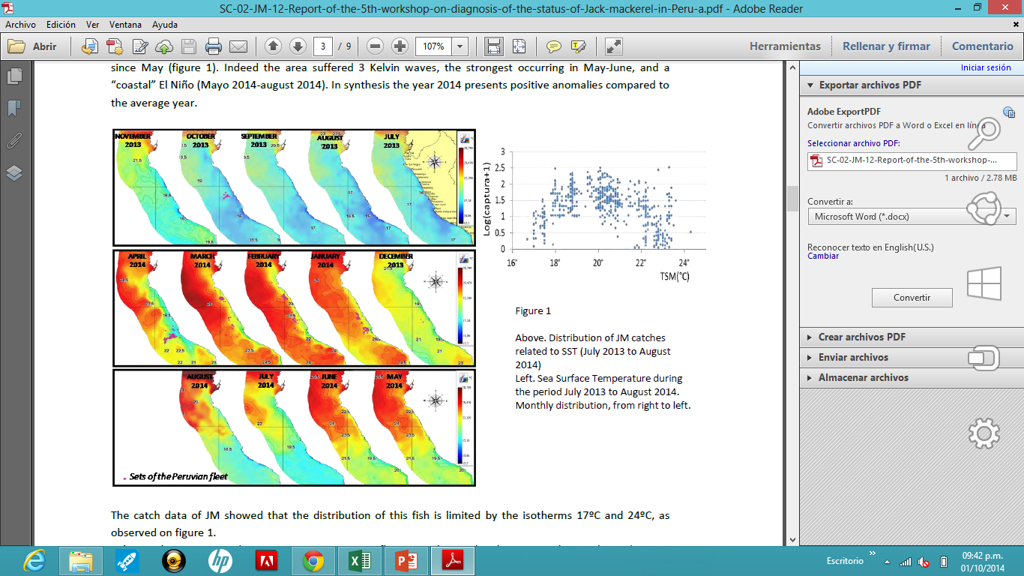
Relationships between the main characteristics of the environment and the JM distribution
Notes:
Sea surface temperature. 2014 is characterized by cold waters at the beginning followed by warm temperatures
since May. Indeed the area suffered 3 Kelvin waves, the strongest occurring in May-June, and a
“coastal” El Niño (Mayo 2014-august 2014). In synthesis the year 2014 presents positive anomalies compared to
the average year The catch data of JM showed that the distribution of this fish is limited by the isotherms 17ºC and 24ºC, as
observed on figure in the right.

Slide 3
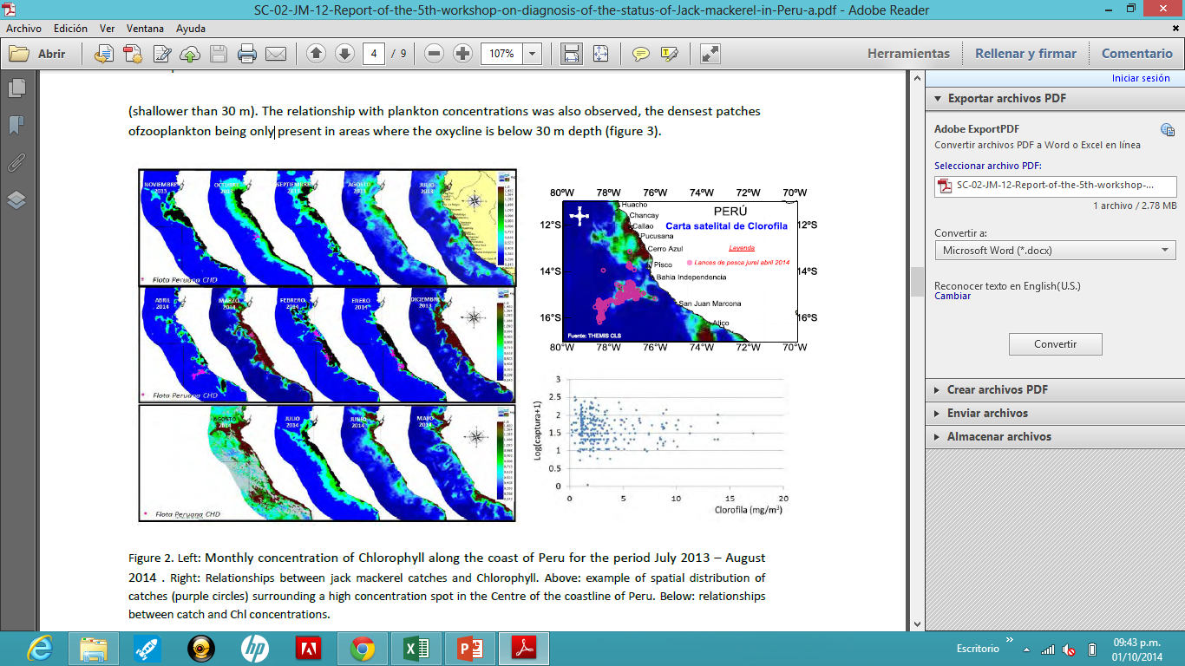
Notes:
It presented high densities of Chlorophyl during the beginning of the year in the Centre area (Callao), decreasing after March, but staying at a rather high level. Since July high concentrations have been observed in the North. Fish concentrations are found in the surroundings of the high concentrations of Chlorophyll.

Slide 4
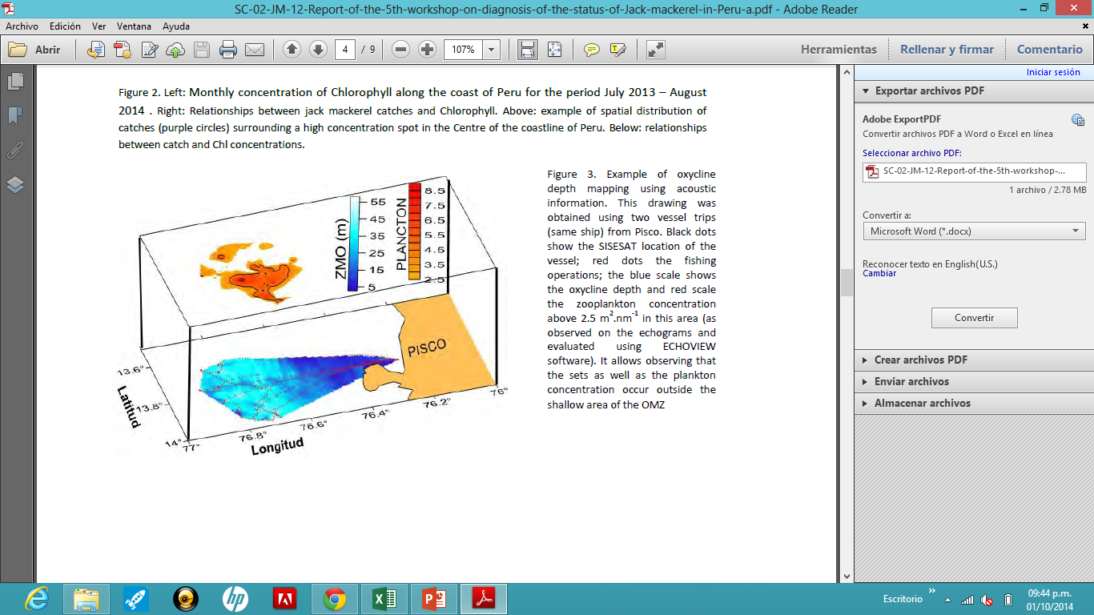
Notes:
Example of oxycline depth mapping using acoustic information. This drawing was obtained using two vessel trips (same ship) from Pisco. Black dots show the SISESAT location of the vessel; red dots the fishing operations; the blue scale shows the oxycline depth and red scale the zooplankton concentration above 2.5 m2.nm-1 in this area (as observed on the echograms and evaluated using ECHOVIEW software). It allows observing that the sets as well as the plankton concentration occur outside the shallow area of the OMZ

Slide 5
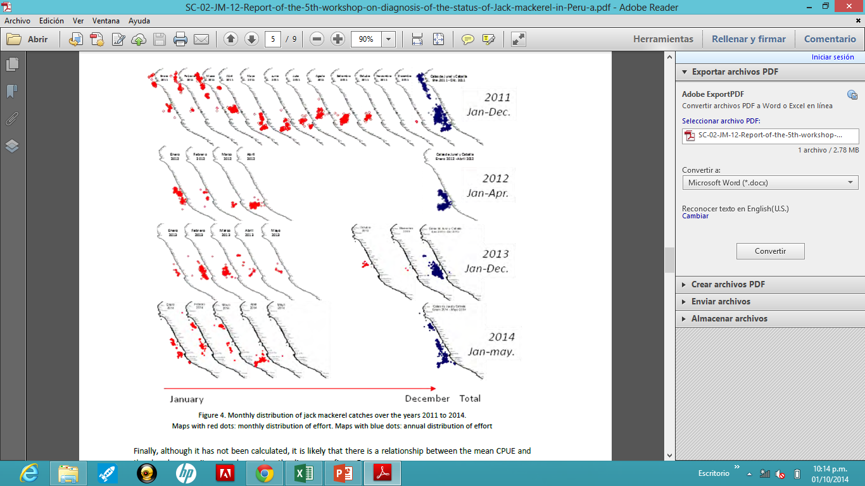
Catches, abundance and biomass3
Notes:
This figure shows a comparative analysis of the spatial distribution of catches between the years 2011 to 2014 . The catches during the first half of year 2014 are distributed all over the coastline north of latitude 15ºS. It is impossible to know whether this limit represents the actual limit of jack mackerel distribution or if it represents the limit of the fishery area of exploitation. Nevertheless it is interesting to observe that catches in 2014 were more similar in their spatial distribution to 2011 than to 2012-2013. The fisheries in Perú is exclusively inside in the EEZ and is not straddling fisheries. The fishing season occurred from January to May (Austral summer and autumn) as in the former years, indicating that resource is more available during these seasons. The CPUE is positively correlated with landings, which allows considering that they are be linked with the SST . Catches are also strongly related to the Chlorophyll distribution and the depth of the oxycline.

Slide 6
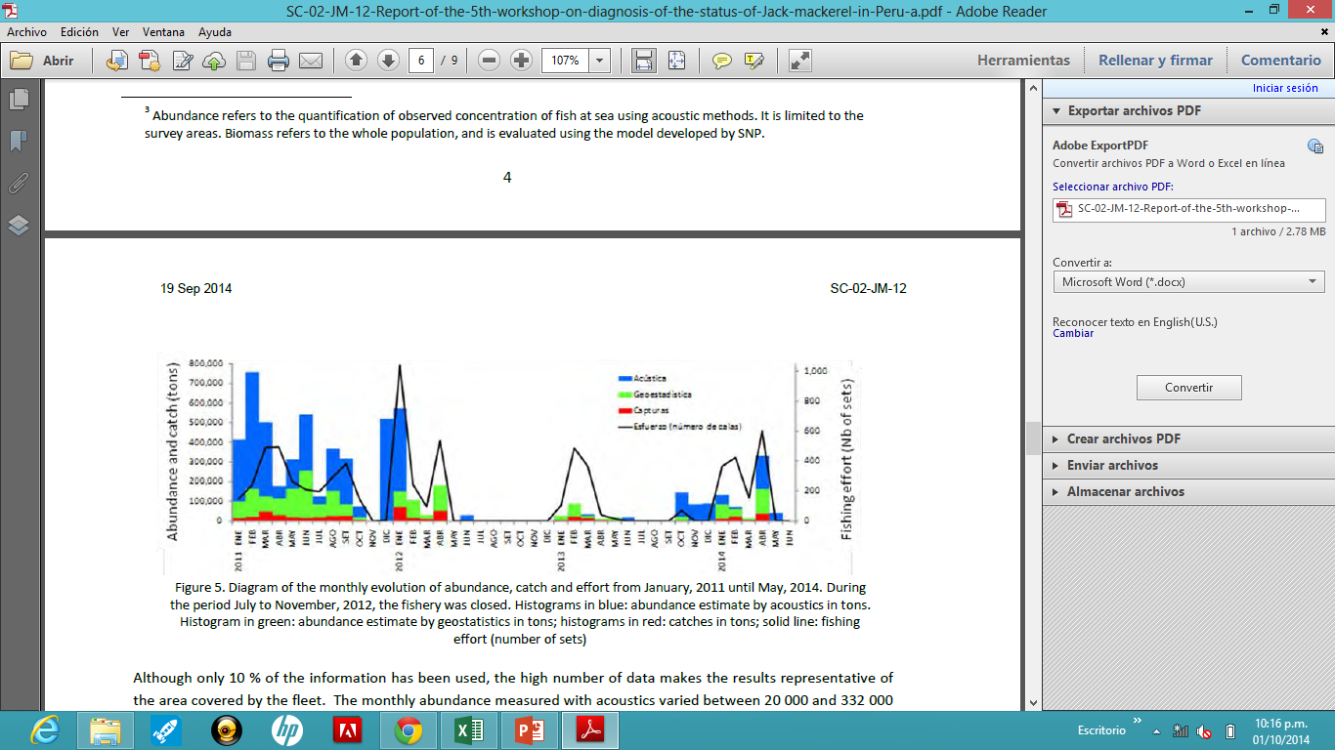
Notes:
Although it has not been calculated, it is likely that there is a relationship between the mean CPUE and
the abundance, as it can be observed on the diagram on figure
Diagram show the monthly evolution of abundance, catch and effort from January, 2011 until May, 2014. During the period July to November, 2012, the fishery was closed. Histograms in blue: abundance estimate by acoustics in tons.; Histogram in green: abundance estimate by geostatistics in tons; histograms in red: catches in tons; solid line: fishing effort (number of sets)

Slide 7

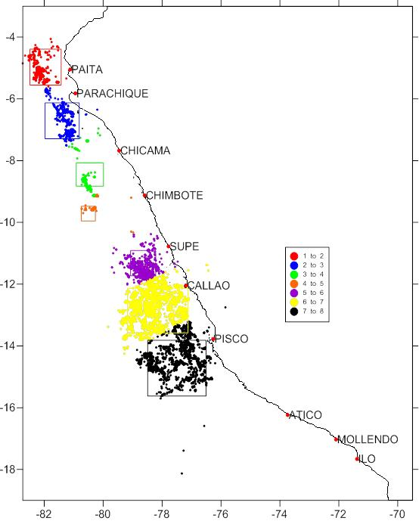
Geostatistica abundance stimation (A)
Regionalización de las calas, y cálculo de la Inercia (I) y Centro de Gravedad (CG)
Estimación de la Abundancia (A) en base a captura media por región (quincenas) como indicador de la densidad (Q, t/mn2).
Estimación de indicador de Esfuerzo (E) en base al númer de calas (NCi) y número efectivo de meses de pesca (M):

Slide 8
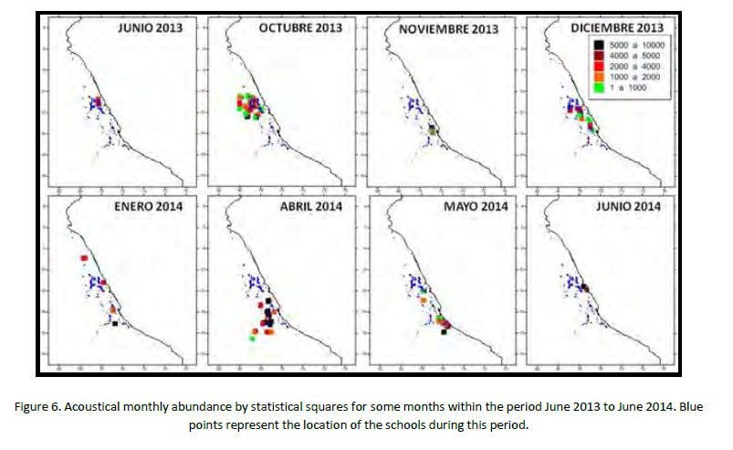
Notes:
The high number of data makes the results representative of the area covered by the fleet. The monthly abundance measured with acoustics varied between 20 000 and 332 000Tons. During the 4 years since the beginning of the monitoring, the monthly values of abundance
fluctuated between 8 000 (March, 2013) and 758 000 tons (February, 2011).
For biomass estimates, the probability model on the JM distribution that was developed in 2013 was applied on
the 2014 data first in April then in August. This model evaluated the distribution area to 14 123 NM2, with a
biomass evaluated between 207 000 and 421 000 tons in April, and between 332 000 and 673 000 tons over an
area of 35 336 NM2 in August.

Slide 9
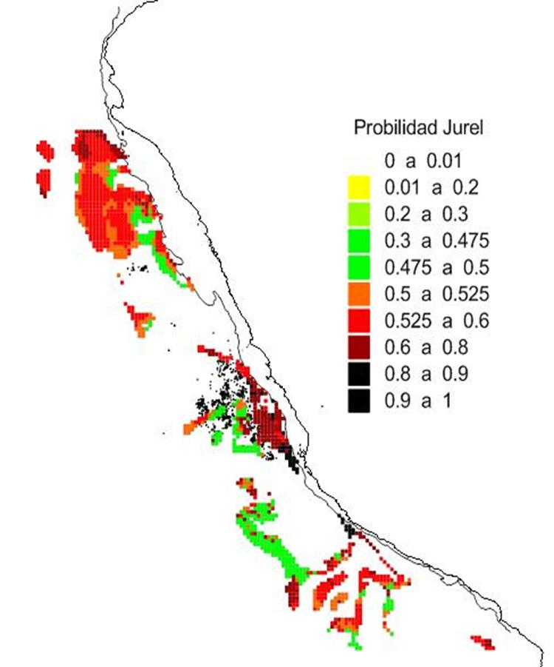
Hábitat Potencial de Jurel
Construido como el promedio de probabilidades (0 a 1) según 6 variables que mejor representan el hábitat potencial del jurel.
Temperatura, anomalías térmicas, salinidad, clorofila, profundidad, y distancia a la costa para cuadros de 26 mn² c/u con P > 0.
Determina el área total probable de distribución de jurel (hábitat potencial).
TSM 15° a 26°C
SSM 35.05 a 35.15 UPS
Batimetría >150m
Clorofila 0.3 a 5 ug.L⁻¹
Anomalías -1 a +1
Térmicas

Slide 10
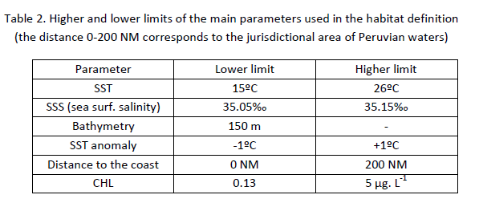
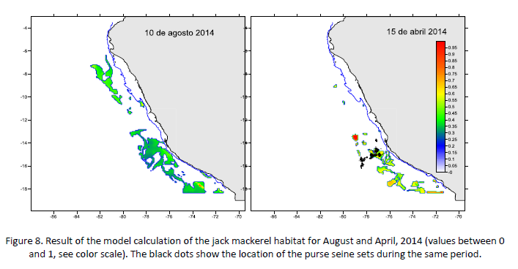
Habitat
Notes:
The habitat was defined with the same parameters as in 2013, as they were confirmed by the oceanographic
measurements. These parameters are synthesized in the table 2.
It is worth noting that these parameters are mostly two-dimensional (horizontal) while the third dimension,
especially as far as dissolved oxygen concentrations (DO) are concerned, is another key parameter to be
considered. This will be a topic for the next workshops.
Using these parameters, the habitat was drawn for each month. An example is given in figure

Slide 11
Conclusions
The year 2013 began as a cold year, but strong anomalies occurred from June to August (-1.4ºC), during which three Kelvin waves arrived in the Peruvian waters in autumn, 2014, resulting in an increase of the SST (+3.5ºC).
In September the SST is still above the average of this month (+0.1 to +0.3ºC). Using these hydrologic results, the potential habitat of jack mackerel could be evaluated and appeared to be less extended than in 2011, especially in the north. Besides, it has been demonstrated that the depth of the oxycline is a key parameter for drawing the potential habitat, which will be done in the future workshops.
The demographic structure of the population was analyzed and showed that during the 1st trimester 2014 the bulk of the catch was done on 3-year old fish. The growth curve of the stock in Peruvian waters is significantly different from the one in other areas of the fish distribution, confirming the specificity of the Peruvian (Far North) subpopulation.
Except in 2011, the fishing season in 2012-2014 was mostly limited to the period January-May (summerautumn). Nevertheless, compared to the former years, 2014 presented warm situations (Kelvin waves), which effect is to concentrate jack mackerel closer to the coast, making it more accessible to the fishery. The CPUE is the lowest in 2014 compared to the high values of 2011-2012 (normal to warm situation) and the medium values of 2013 (colder situation), which is likely due to the extension of the fishing ground at larger distance to the coast. The biomass measured with acoustics varied between 20 000 and 332 000 tons. During the 4 years monitored, the biomass fluctuated between 8 000 (March, 2013) and 758 000 tons (February, 2011). The distribution area fluctuated between 268 MN2 (May, 2013) and 3 373 NM2 (June 2011); and the catch between 1 200 and 73 000 tons. The total catch for the 4 years was 518 000 tons.

