Slide 1

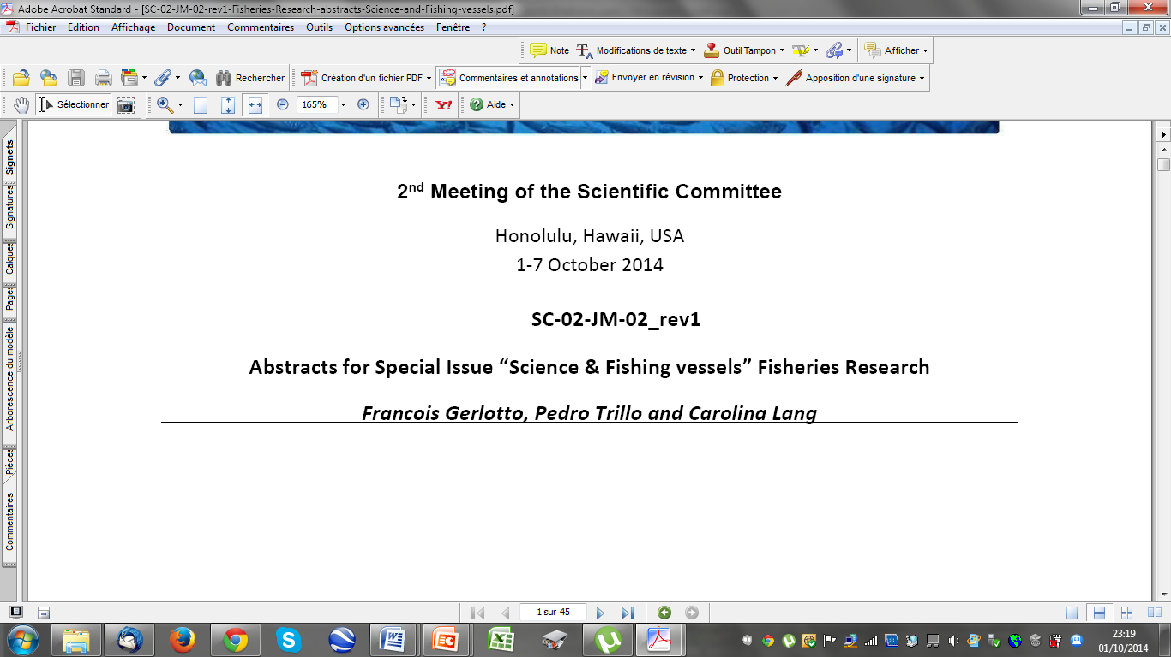

Slide 2
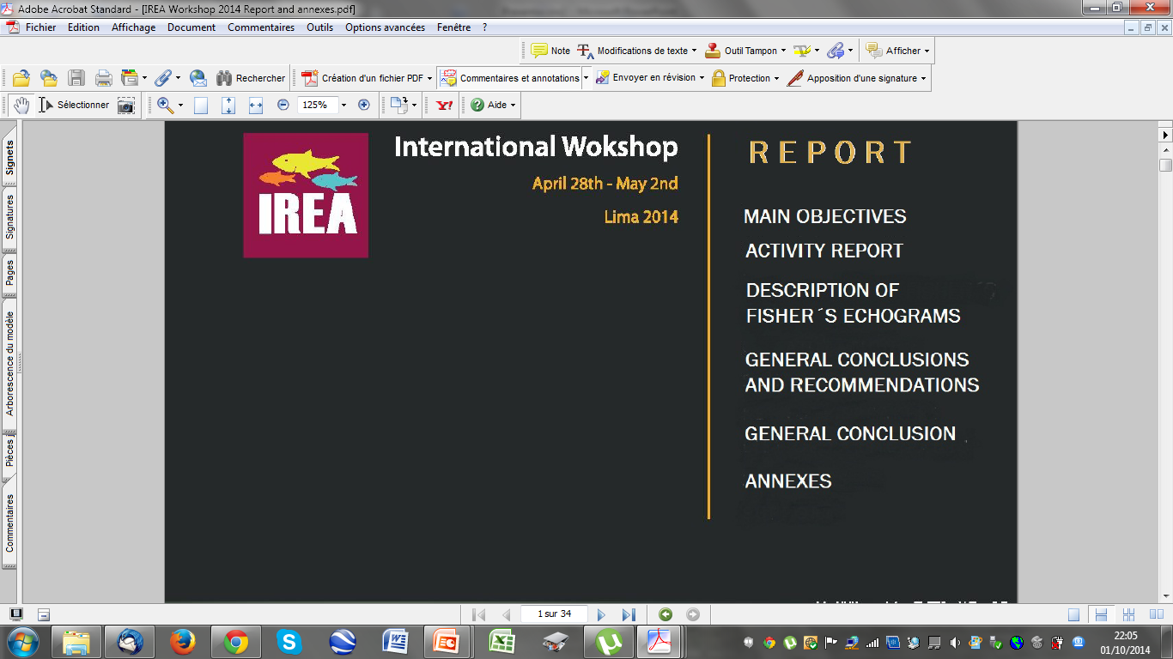
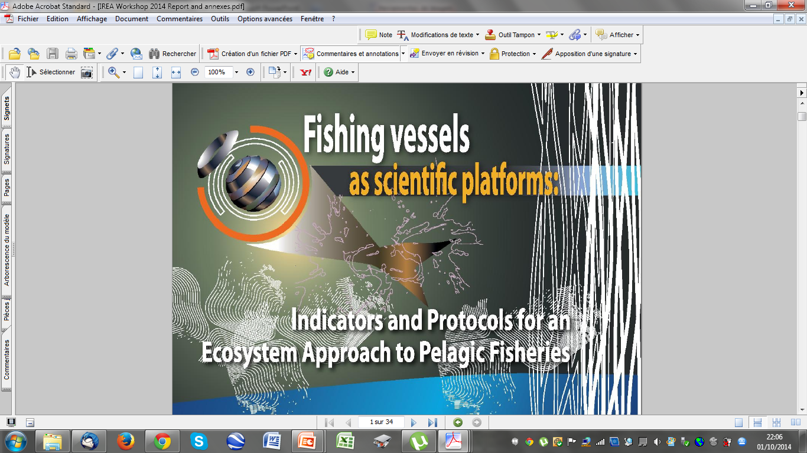
SPRFMO contribution
SC-02-JM-01
Gathering scientists from
Australia
Canada
Chile
Colombia
Ecuador
France
Netherland
Peru
USA

Slide 3
Main objectives
(as recommended by SPRFMO in its Research Program)
To produce a state-of-the-art on the use of acoustic data collected aboard fishing vessels for scientific research;
To consider the consistency of the indicators defined during the SNP workshops in Peru using acoustic informations (among others, see SC-02-JM-12.);
To produce a series of recommendation for the improvement of data collection techniques and methods, processing and analysis of the data structure of the data base, etc.
To consider the possibility of designing a common format for fishers’ acoustic data;
To consider the possibility of publication of a series of papers on the topic

Slide 4
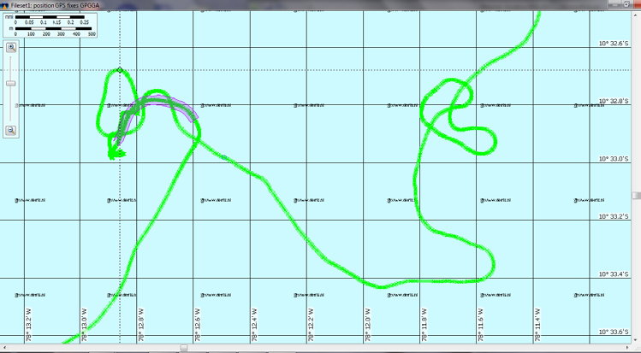
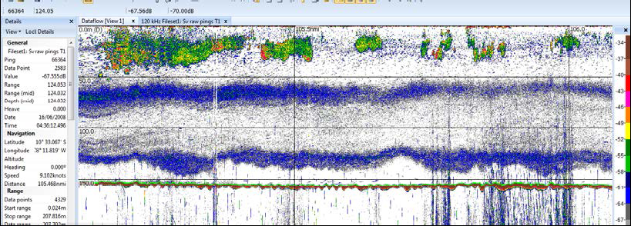
Description of fishers’ echograms.
Example of the route of a single trip (Routes from-to the fishing grounds are not displayed). The echogram below is obtained along the highlighted part of the route
Echogram from search loop, but no fishing occurred

Slide 5
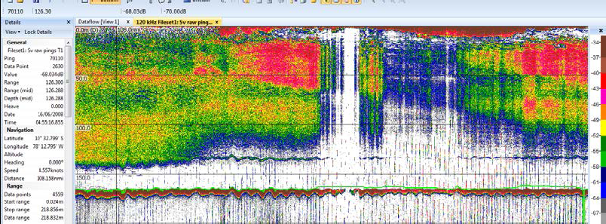
Echogram from area where set was taken. This portion of data must not be used in estimates of mean backscatters.

Slide 6
RECOMMENDATIONS FROM THE WORKSHOP
To produce a state-of-the-art on the use of acoustic data collected aboard fishing vessels for scientific research
Need for designing a simple and efficient calibration procedure
Need to understand clearly the significance of fisher “sampling strategies” and to design adapted statistical methods.
A complete protocol must be created gathering the main sources of data (acoustics, observers, landings and environment).
Develop comparison between the fishing vessels and research vessels acoustic data (trips and surveys)
The development of new instruments and techniques interesting for both the fishers and the scientists e.g. the multibeam systems and the broadband vertical echosounders.

Slide 7
To evaluate the scientific pertinence of the works performed during the SNP workshops on jack mackerel;
need for a detailed documentation on the data base and protocols; quality control of the data
It is essential that the cooperation between scientists and the fleet be permanent and fully accepted by both sides;
the fleet should receive and exploit in real time the information (indicators) calculated by the scientists.
increase the effort in comparison between acoustic vs. catch selectivity

Slide 8
To consider the consistency of the indicators defined during these workshops using a series of informations (acoustic, fishery, environment, behaviour, etc.)
interconnect the different sources of data (e.g. acoustics with environment). The GPS time (common to all the ships) is used for inter-vessel analysis.
Some settings of the vessels are likely to change the value of the data and prevent any use beyond qualitative observation and results if not corrected.
the skippers’ abilities should be compared:
A few more indicators could be easily obtained and would dramatically enrich the data base e.g.oxycline routinely extracted from the echograms;
school size and metrics are other sources of indicators; etc.
The case of the gravity centre: its value is at the base of a series of calculations and particularly the abundance.
synthesizing indicator, and simple approaches are not free of biases

Slide 9
To produce a series of recommendation for the improvement of the data collection techniques and methods, of the processing and analysis of the data, for the structure of the data base, etc.
Need for comparison, intercalibrations, etc. of scientific surveys and fishers data base;
Optimal settings of acoustic devices e.g. standardization of the data output, compatibility of data bases developed under different situations (countries, fleets, fishing methods…);
Need for considering the development of easy common tools for allowing all the companies to reach the level of the strongest ones.
Not all the fishing companies can/want to process themselves their data. There is need for an independent structure that could process the data from any origin and input them in the common data base.
Define calibration procedures. Calibration must be performed for all the vessels which data are integrated in the data base.

Slide 10
Processing/analysis of the data collection methods.
Data base. Conceiving a final format for the data base appears to be a priority. Some works on this field already exist, and the ICES work on metadata base could be adapted .
There is a practical need for precise analysis of data compatibility (e.g. time as common information). In any case VMS data are given using the same GPS time values, making correction of the vessel recorded time possible.
Additional data could be collected for improvement of the data base, e.g. oxycline, pH of the ocean, zooplankton densities and abundance, species ID and classification, etc.

Slide 11
Agreement was given by the journal Fisheries Research (Elsevier) for a special issue on “Fishing vessels as Scientific Platforms” to be published during 2015.
Abstracts from a total of 32 contributions were received from all over the world*. Manuscripts should be received in January, 2015
What are the major reasons of the use of fishing vessels as scientific platforms?
* Australia, New Zealand, Chile, Peru, Colombia, USA, Canada, Netherland, Italy, UK, France, Spain, Norway, China, etc.

Slide 12
TO INTEGRATE THE INFORMATION FROM DIFFERENT SOURCES
Acoustic data from fishing vessels
Analysis CPUE vs. density
Observers’ logbooks
INDUSTRY
Ecology
Acosutic surveys
(research vessels)
Behaviour at different scales
Biomass evaluation and distribution area
ILSBORATORY
Definition /delimitation
of habitat
Oceanography

Slide 13
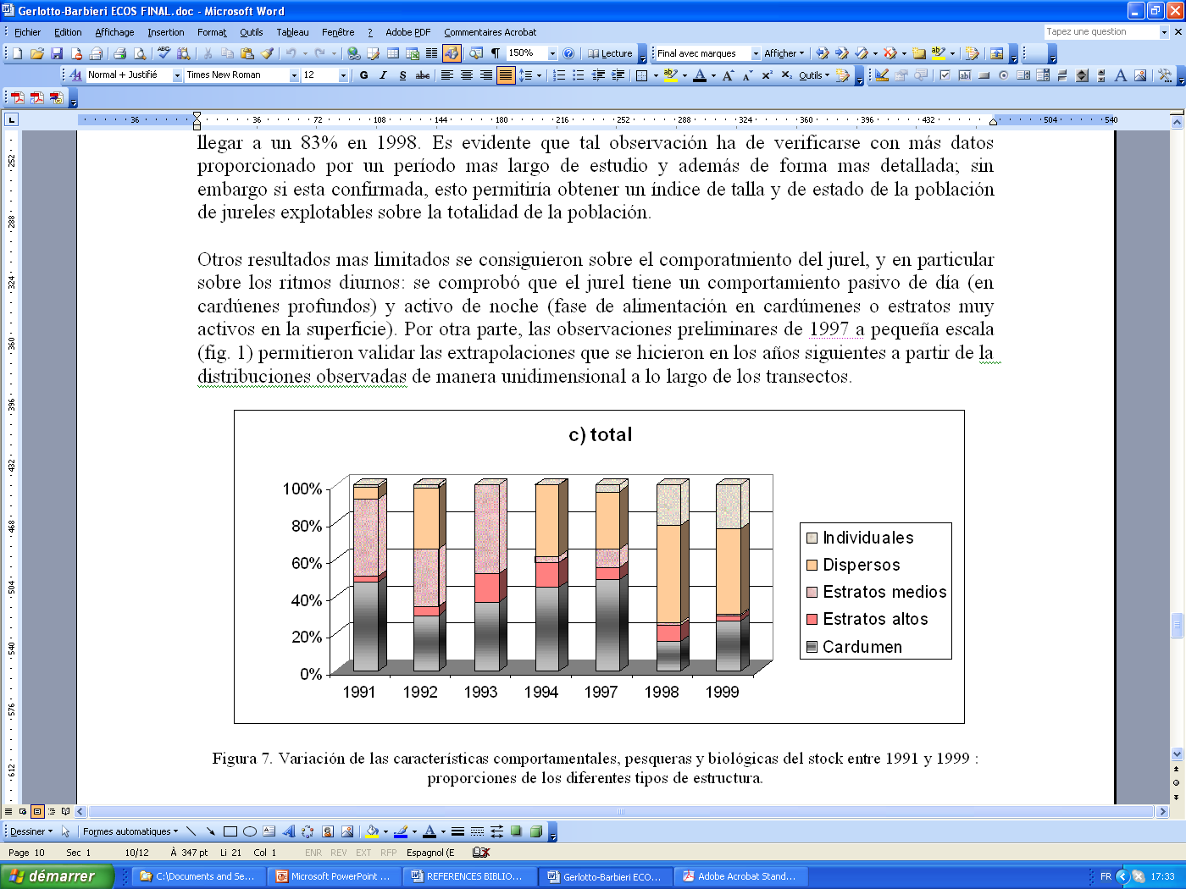
TO DEFINE A LIST OF COMMON INDICATORS FOR ALL THE FISHERIES (I)
Similarity of types in Chile and Peru
Sensitivity to El Niño events

Slide 14
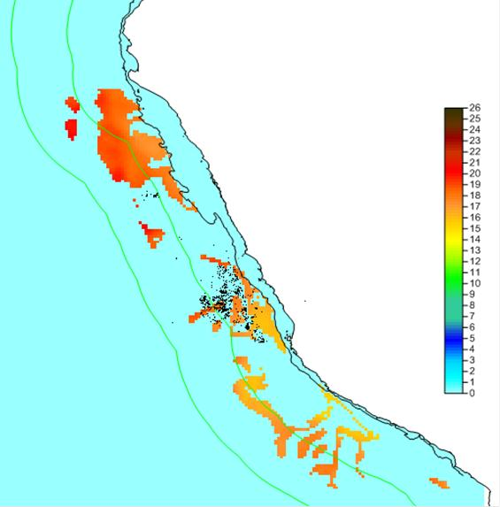
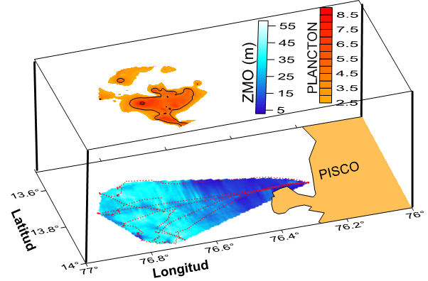

TO DEFINE A LIST OF INDICATORS FOR ALL THE FISHERIES (II)
Minimum Oxygen Zone and Habitat
Depth of the oxycline (left, below), high concentrations of zooplankton (left, above), definition of the habitat (right) from SNP workshops

Slide 15
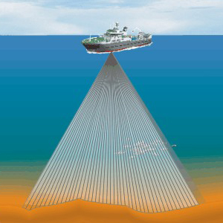
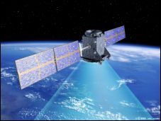
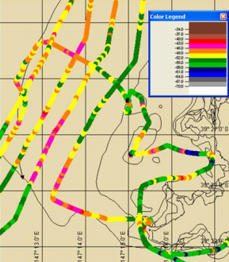
TO COMBINE TECHNOLOGIES AND DATA FROM DIFFERENT SOURCES

Slide 16
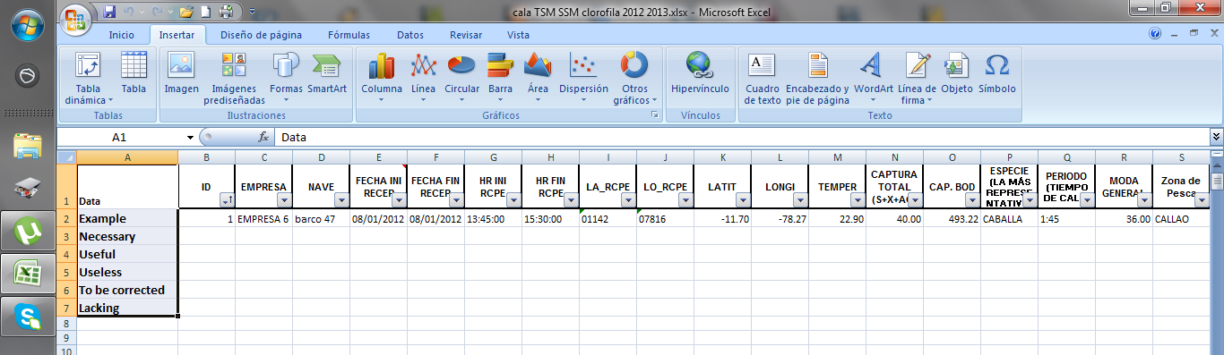
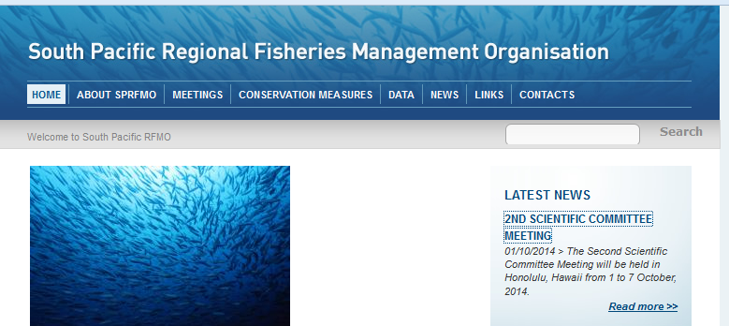
TO ORGANISE AND PRODUCE DATA BASES FOLLOWING SPRFMO RECOMMENDATIONS

Slide 17
ONE OBVIOUS CONCLUSION:
Request for the implementation of a SPRFMO task group on “fishing vessels as scientific platforms”
Objectives
Technical : to establish common protocols for collection (settings, calibration) and analysis (common list of indicators)
Scientific: to develop common (international) analyses to describe the population structure and dynamics (recruitment, migrations)
Cooperation: to make available to everyone a “methodological package” developed under international supervision
Why under SPRFMO flag? Need to be developed under international agreement

Slide 18
Benefits
For fishing companies: get a clearly defined protocol for data collection, processing and analysis
For SPRFMO: get access to results from a new source of direct data for monitoring the whole exploited ecosystem
For scientists: having a source of reliable indicators for ecosystem surveys and research

Slide 19
Organization
Create under the chairmanship of François Gerlotto (IREA).
Gathering scientists, engineers and technicians from Research Institutes, fishing companies and organizations (e.g. IFOP , INPESCA, INPESNOR, CORPESCA from Chile; IMARPE y SNP from Perú; CSIRO from Australia; NIWA from New Zealand; IRD, IMARES from EU; etc..).
Working by mail during the year with one workshop each year before the SPRFMO SC meeting .
Follow the recommendation of the workshop on Fishing vessels as scientific platforms (see above) studying a given (series of) topic(s) each year (First activity 2015: to design a common protocol for calibration and settings)
Fundings:
  Current activity covered by IREA
  Workshop cost to be covered by the fishing companies (e.g. via SNP in Peru), travels at expenses of participants.
  (… or funded by any other sponsor which will be warmly welcome)

